Slide 1
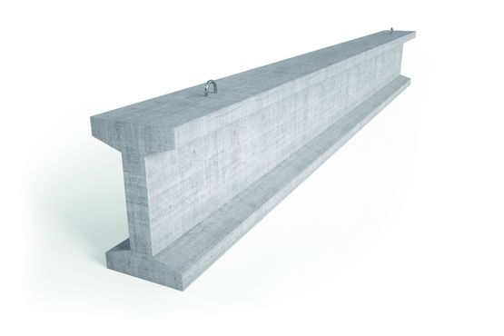
January 14, 2021
Iteration review 1
Victorien Hannequin
Laurène Anglade
Estelle Jameux
Antoine Maury
Lucas Defrance
Julien Pérémé
Valentine Lecomte
I) Internal Structure
II)External Structure
III) Deployable solar panels

Slide 2
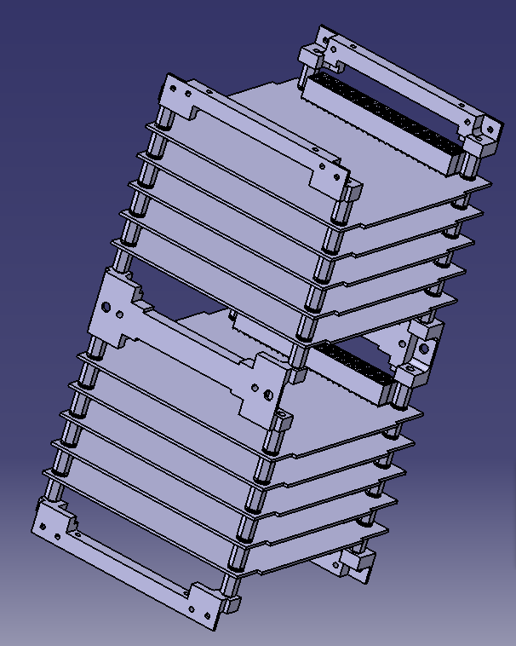
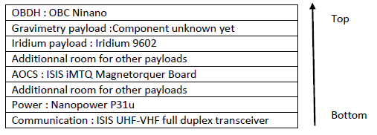
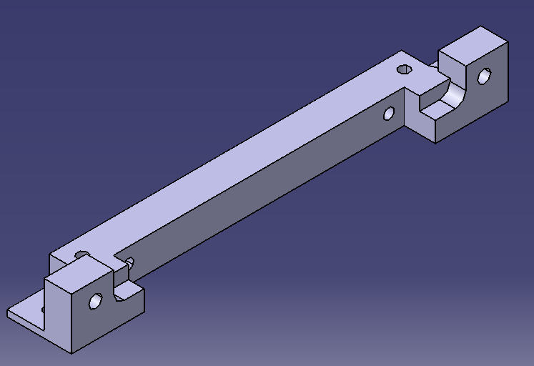
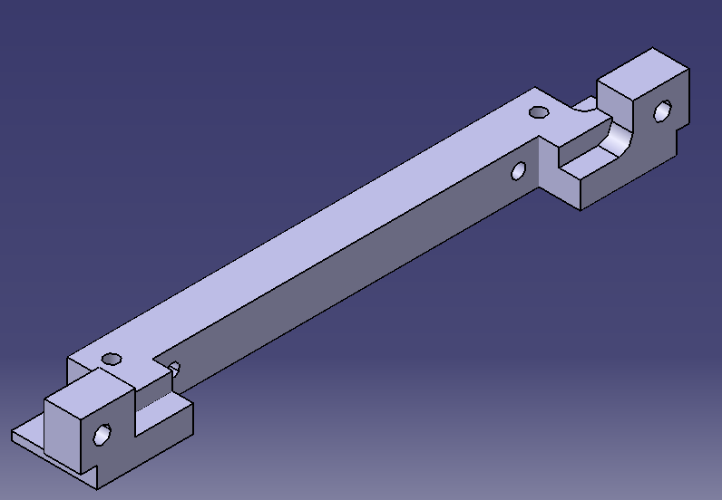
Internal structure
Iteration review 1

Slide 3
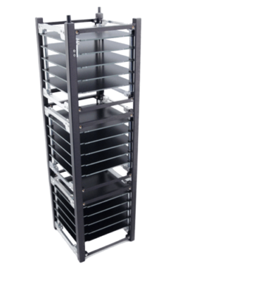
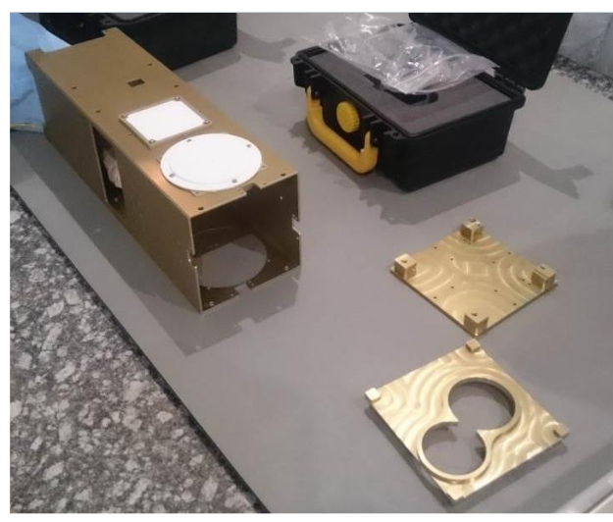
External Structure
Too fragile, expensive Much more solid (cheaper)
Iteration review 1

Slide 4
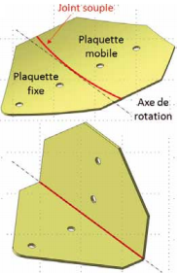
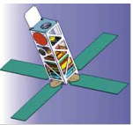
Deployable solar panels
Deployment system :
Composite hinge made by CLIX Industries
Pros :
Self-deploying/locking,
light, no need for extra power,
can be adapted to our needs
Cons :
We need to come up with
a thermal knife system
Iteration review 1

Slide 5
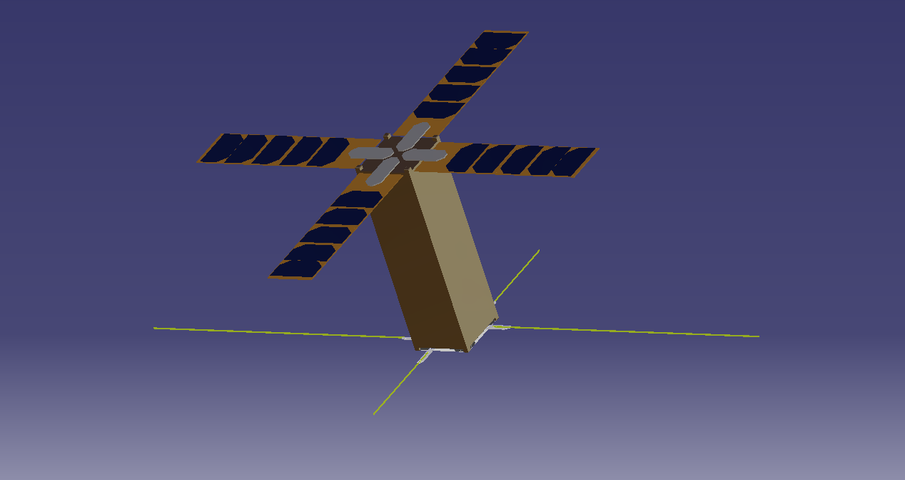
Thank you !
Feel free to ask any question
Iteration review 1

